Slide 1
Welcome to the Class
PASS: great start, Parth!
Lab Assignment
email address:
partner’s email address:

Slide 2
Instructions: Make a copy of this document, place the copy into your submissions folder, fill it with your responses and include a link to it when you submit via the lab assignment submission form. If you work on this with a partner then include your partner’s email address in the assignment submission form and on the title page of this document.
With each question, use the space on the slide to show your response. Add additional slides as needed.
Paste images into the document as needed.
Use the Assignment Submission Form to submit your completed assignment

Slide 3
1. Create your submissions folder in GDrive
done

Slide 4
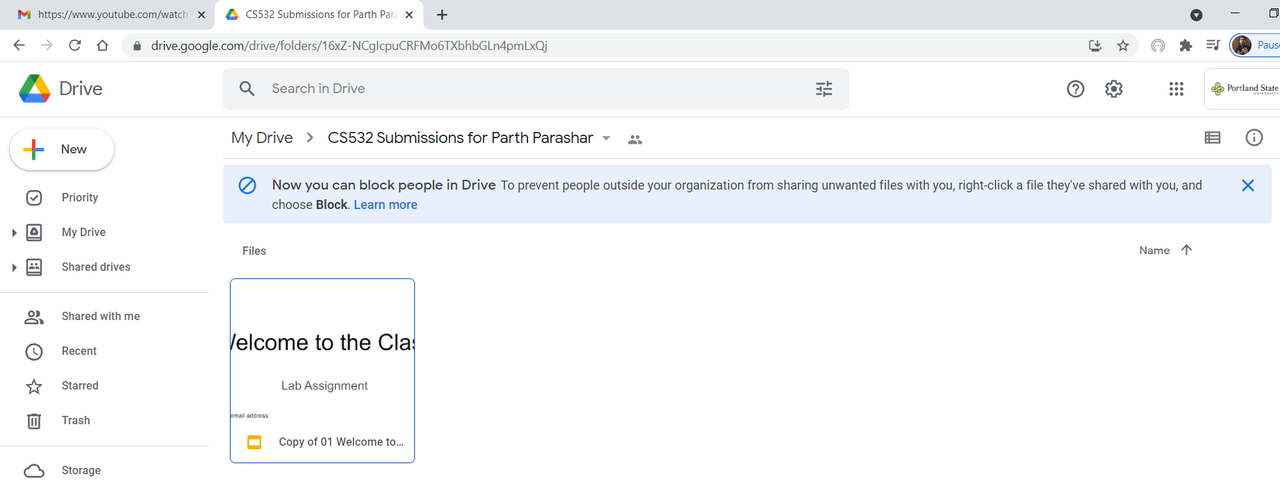
2. On this page, paste a screenshot that shows that you named the folder “CS532 Submissions for <student name>”

Slide 5
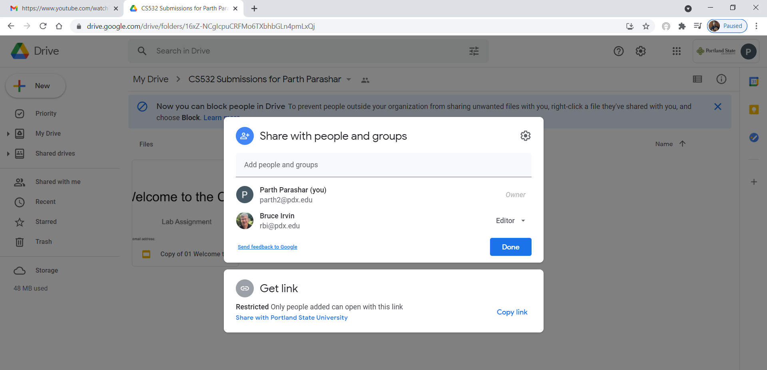
3. Paste a screenshot that shows that you shared your submissions folder with Bruce.

Slide 6
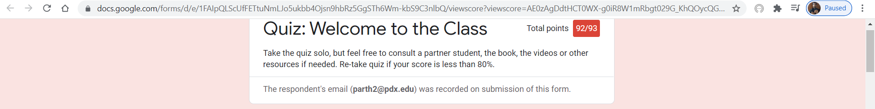
4. What score did you receive on the quiz for this topic? Did you score at least 80% (no rounding)?
Yes, I received a score of 98.92%

